Slide 1
Problem statement
In today’s world people are suffering with mental stress which is becoming a serious issue as it leads to depression.
To detect depression, mood, and predict human behaviour one this is important i.e. emotion detection.
So it is important to understand the emotion of a person first in order to pass judgement or help them.

Slide 2
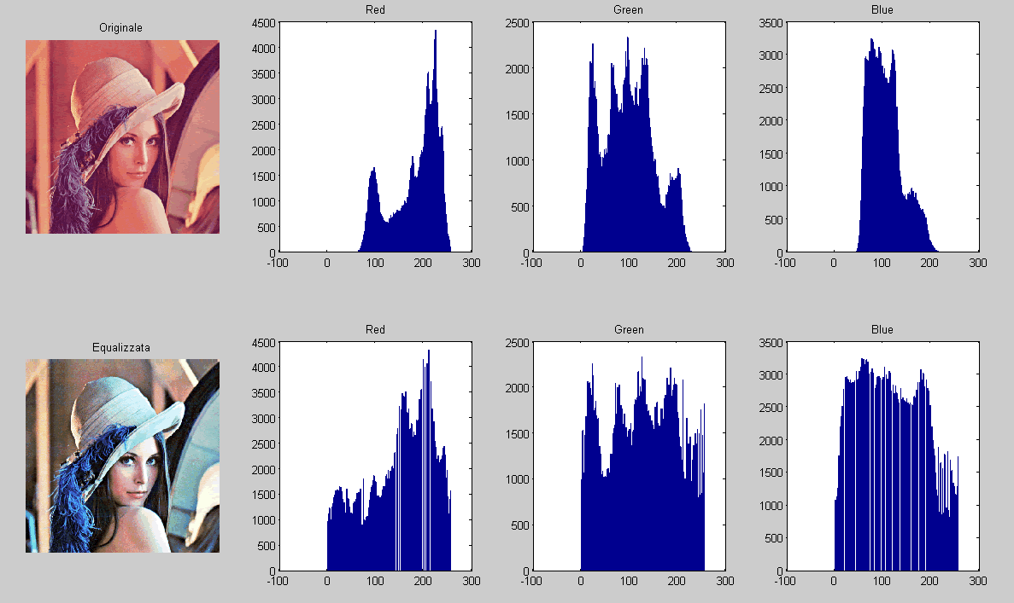



Objective
Emotion recognition using image processing techniques
To create a model who can classify various types of emotion

Slide 3
Introduction
Emotion Recognition is an important area of research to enable effective human-computer interaction. Human emotions can be detected using speech signal, facial expressions, body language, and electroencephalography (EEG). Emotion is a mental state associated with nervous system associated with feeling and behavior.
Our objective is to train a model to predict the emotion of a human face given through an image. To do this we will create a model which we will train under 7 different emotion types namely ‘Angry’, ‘Disgust’, ‘Fear’, ’Happy’, ’Sad’, ’Surprise’, ’Neutral’.

Slide 4
Proposed systems
LBPH Face recognition
And open CV
TensorFlow.MobileNetV2 and Keras.layers

Slide 5
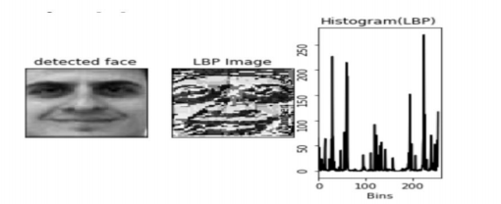
Local Binary Patterns Histogram (LBPH)
Local Binary Patterns Histogram algorithm was proposed in 2006. It is based on local binary operator. It is widely used in facial recognition due to its computational simplicity and discriminative power.
In simple terms, LBPH algorithm converts the detected face into a Binary pattern image and creates a histogram for it.

Slide 6
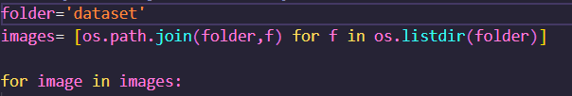
Implementation steps:
create 2 empty lists for faces and each corresponding ids
2. loop over data set and access each image

Slide 7
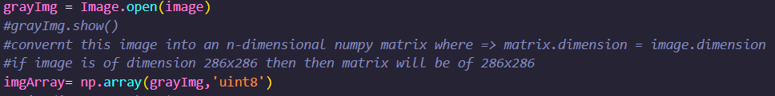
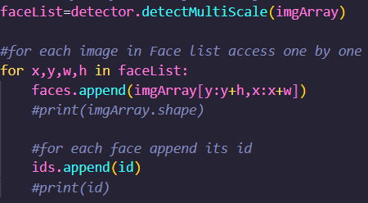
3. for each image in images
3.1. Open image with Pillow then convert image in grayscale
3.2. Convert the grayscale image into NumPy array.
3.3. With the help of Haarcascade Classifier detect faces in the image
3.4. Append the faces in faceList and corresponding id in idList.

Slide 8

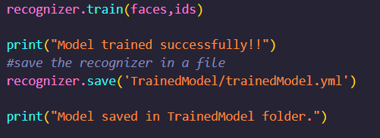
4. Create a recognizer object using LBPHFaceRecognizer_create()
5. In the recognizer.train() function pass face and id array as parameters.
6. Save the model and start testing.

Slide 9
Results
While testing this model, we are getting a ~70% accuracy for the testing dataset
and 100% accuracy while using the same training dataset.

Slide 10
Using Transfer Learning (MobileNetV2)
Since the accuracy of previous model was less we created another model using Keras layers and a pre trained model called MobileNetV2.
TensorFlow offers various types of pre trained model, which allows to identify approximately 1000 different objects.
Keras Applications are deep learning models that are made available alongside pre-trained weights. These models can be used for prediction, feature extraction, and fine-tuning.

Slide 11
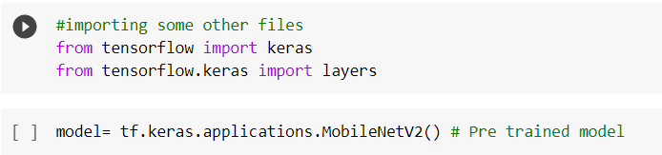
MobileNets are small, low-latency, low-power models parameterized to meet the resource constraints of a variety of use cases. They can be built upon for classification, detection, embedding and segmentation similar to how other popular large scale models, such as Inception, are used.
Implementation steps:
1. Create an model with help of tensorflow.applications.MobileNetV2.

Slide 12
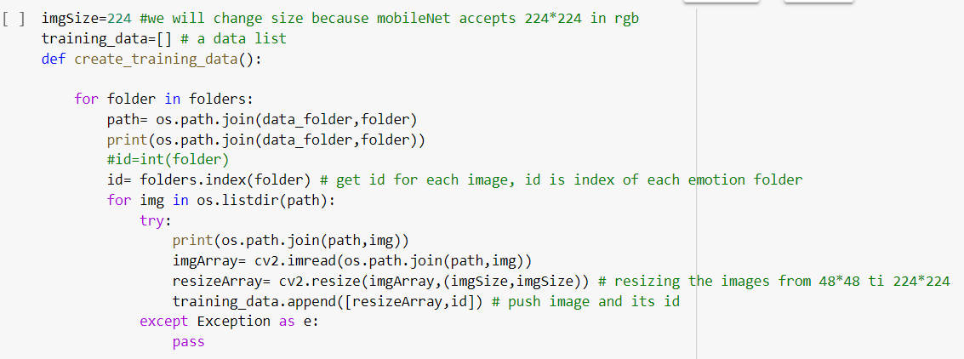
2. By default, layer takes input of 224x224 size images so will resize all the images.

Slide 13
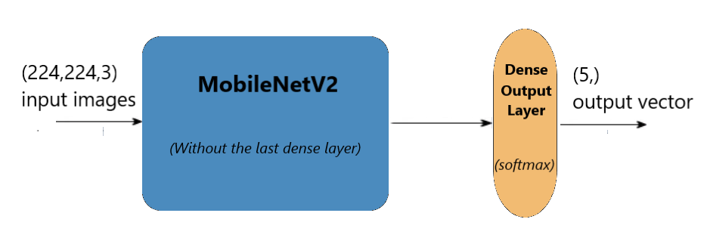
3. MobileNet model is designed to have output layer for around 1000
objects, but we only need 7 objects as we have to classify only for 7
different emotions.
(7,)

Slide 14
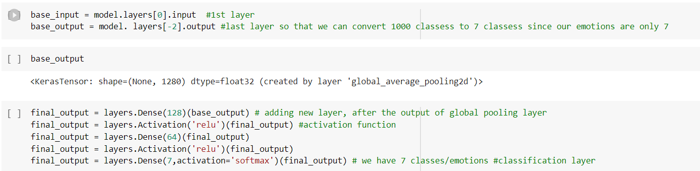
4. Change base output layers from 1000 to 7.

Slide 15
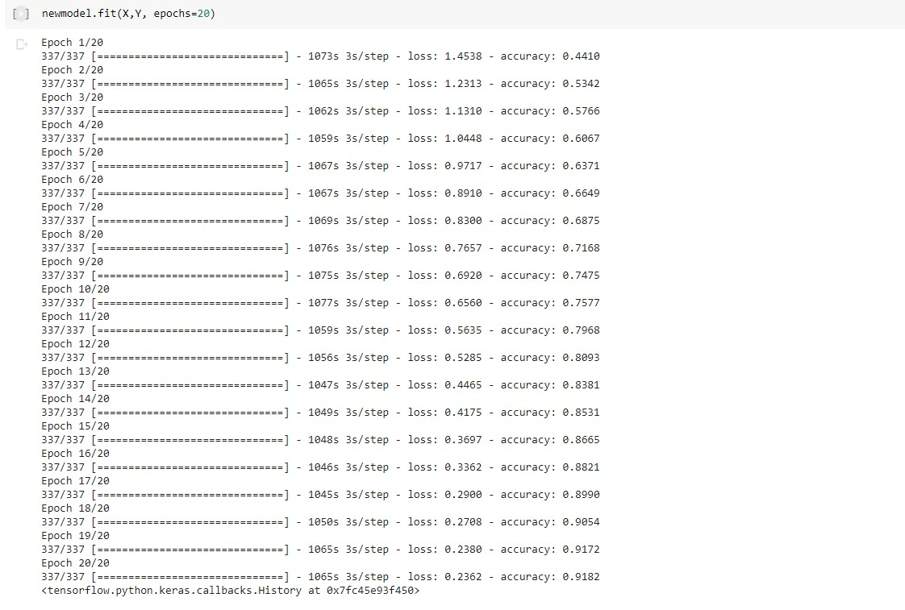
5. Create and compile new model and train with 20 epochs

Slide 16
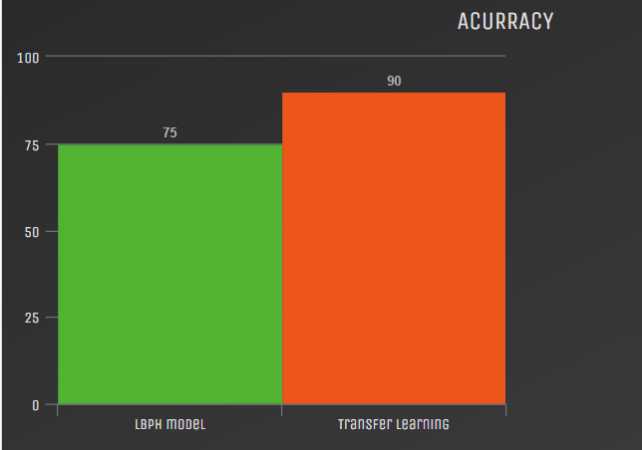
Results
While testing this model, we are getting a 85-90% accuracy for the testing dataset
and 100% accuracy while using the same training dataset.

Slide 17


Conclusion
The model rarely misunderstands some emotions like surprise as fear, disgust as
surprise, sad as anger/disgust or even a straight face as a smile. Due to which we may face some inaccuracy.

Slide 18

Thanks and Regards
Click to get code /dataset or scan::
Submitted to: Prof Vandana Kate
Presented by: Sanchit Patidar
0827CI191050

